Slide 1
The Zine Union Catalog
and Opportunities with the DPLA Community
Jennifer @lasuprema & Allison @AllisonJaiODell for the Zine Libraries Interest Group, Zine Union Catalog Team

Slide 2
Outline
Intro to zines & zine library landscape
ZUC goals
ZUC challenges
DPLA collaboration(s)?
Jennifer @lasuprema & Allison @AllisonJaiODell for the Zine Libraries Interest Group, Zine Union Catalog Team
Notes:
Intro to zines & zine library landscape
ZUC goals
ZUC challenges
DPLA collaboration(s)?

Slide 3
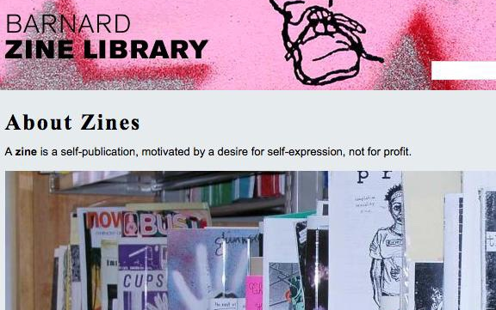
Zines 101
Jennifer @lasuprema & Allison @AllisonJaiODell for the Zine Libraries Interest Group, Zine Union Catalog Team
Notes:
“… a self-publication, motivated by a desire for self-expression, not for profit.” So, made for love, not money.

Slide 4
Zines 101
Self-produced and self-published
Non-commercial
Frequently counter-cultural topics
Usually periodicals and usually off-schedule
Jennifer @lasuprema & Allison @AllisonJaiODell for the Zine Libraries Interest Group, Zine Union Catalog Team
Notes:
Self-produced: rare materials; circulated by their makers (zinesters) and specialized distros
Counter-cultural topics: circulation embodies communities; need for privacy; document events, movements, scenes, subcultures, etc not documented elsewhere = research
Usually off-schedule: hard to catalog/control/organize; hard to know if you’re missing issues; individual libraries tend not to have a full run, have to consult multiple libraries to see all available

Slide 5
Zine Library Landscape
Zines are available in:
special collections and archives
public libraries
independent zine libraries and infoshops
http://zinelibraries.info/directory/
Jennifer @lasuprema & Allison @AllisonJaiODell for the Zine Libraries Interest Group, Zine Union Catalog Team
Notes:
Zines are collected by academic libraries as primary-source documents on politics, arts, social life, subcultures, and more; by public libraries as relevant to the interests of community members, especially teens; by independent zine libraries and infoshops for a variety of reasons.

Slide 6
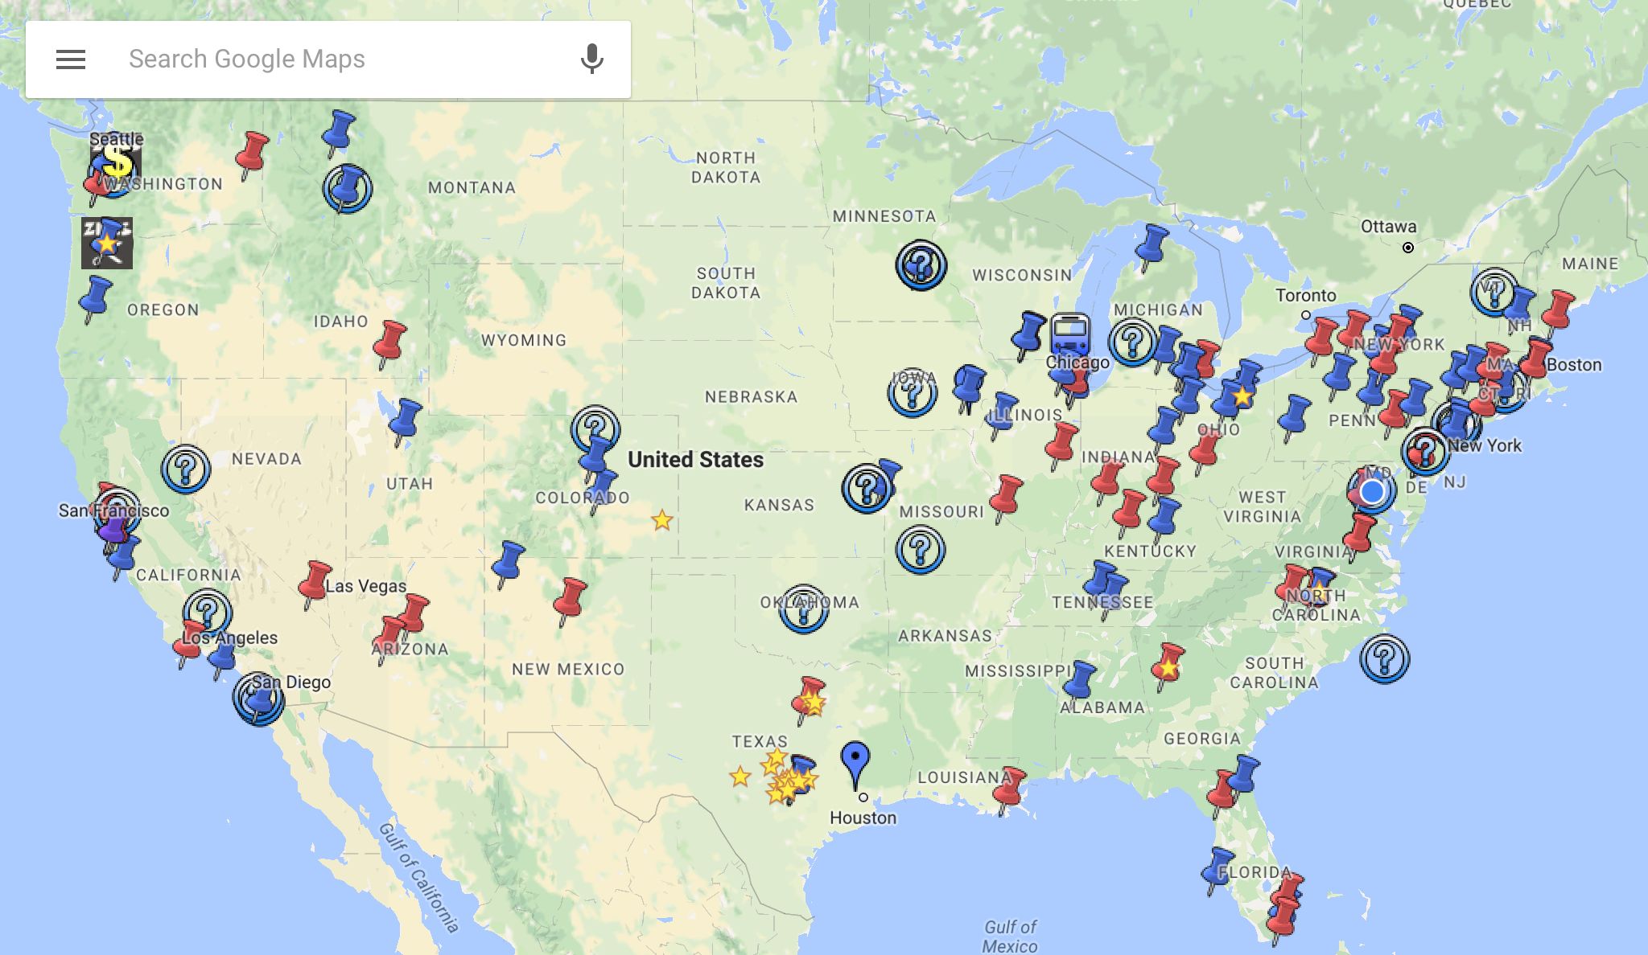
Jennifer @lasuprema & Allison @AllisonJaiODell for the Zine Libraries Interest Group, Zine Union Catalog Team
Notes:
Here’s a map of self-identified zine libraries or collections.

Slide 7
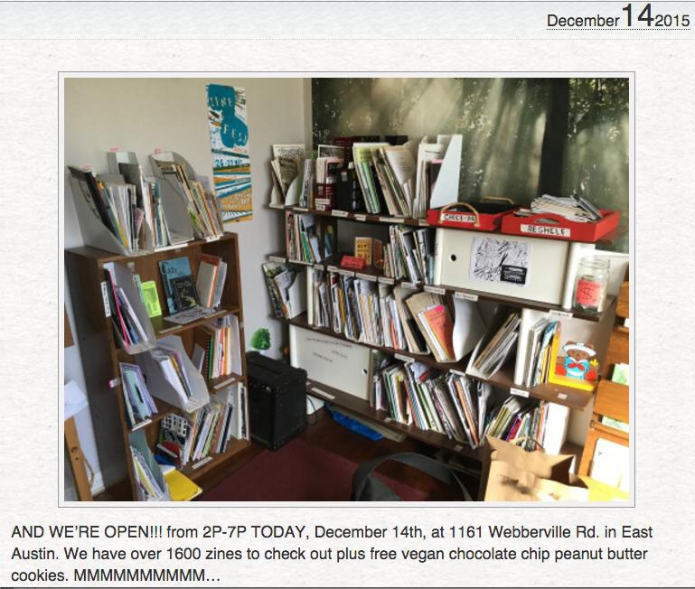
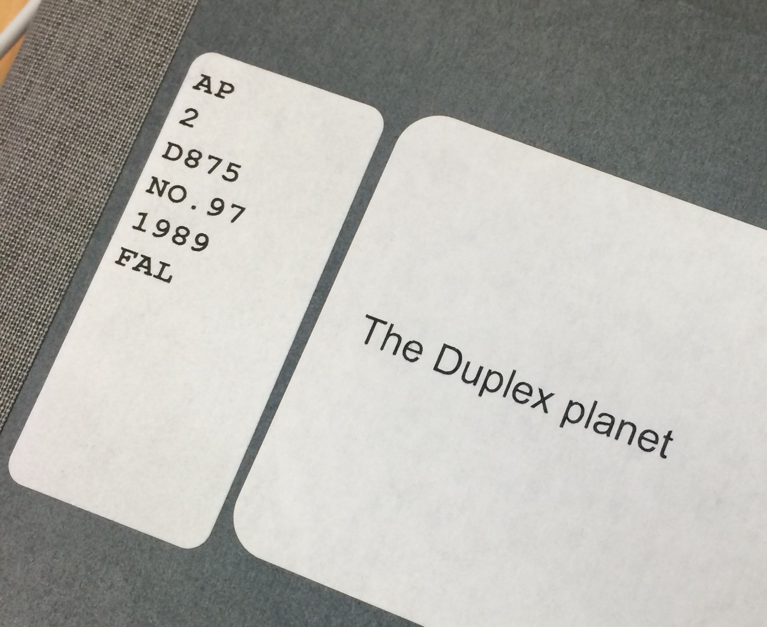
Jennifer @lasuprema & Allison @AllisonJaiODell for the Zine Libraries Interest Group, Zine Union Catalog Team
Notes:
Because of this heterogeneous zine library landscape, access to zines is currently spread across many different data silos: some represented in WorldCat, but mostly in standalone catalogs, finding aids, local databases and spreadsheets, LibraryThing, and other ad-hoc solutions. Currently, no ability to search across zine holdings, and little ability to integrate data from different sources.

Slide 8
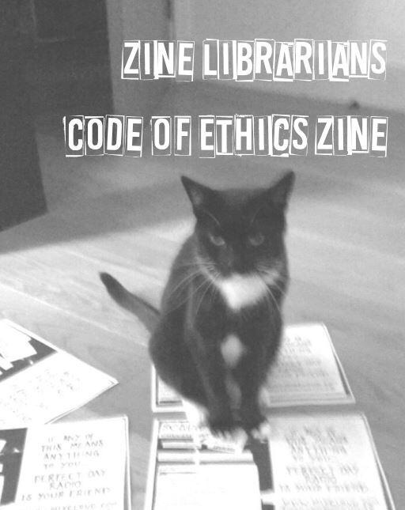
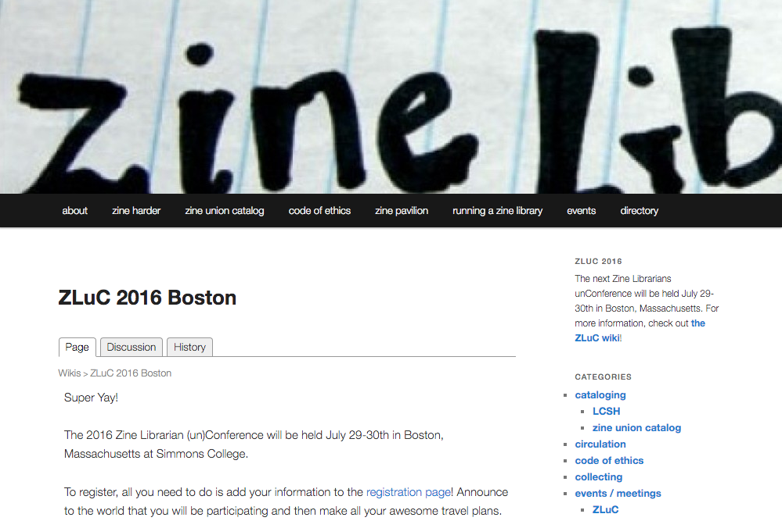

Jennifer @lasuprema & Allison @AllisonJaiODell for the Zine Libraries Interest Group, Zine Union Catalog Team
Notes:
A national group composed of all sorts of librarians, including “barefoot” librarians (ones without formal training), come together every year or so of the Zine Librarians (un)Conference. Last year, we were in Austin, and this summer we’re heading to Boston -- join us! There’s also a website with lots of helpful information, a wiki, and email list. Started in the summer of 2014 at our meeting at Duke, the collaboratively-written Zine Librarians’ Code of Ethics was recently released -- you can find it on the website, in PDF format for easy zineification.

Slide 9
Zine Union Catalog (ZUC) Goals
Find and access zines across collections
Centrally & cooperatively catalog zines
Metadata reflects the ethics, norms, and privacy concerns of the zine community
Integrated access to digitized and electronic content
Jennifer @lasuprema & Allison @AllisonJaiODell for the Zine Libraries Interest Group, Zine Union Catalog Team
Notes:
Dream: WorldCat for zines, but open to participation/contribution from anyone, any library or “library”. Project is an opportunity to imagine a union catalog for the 21st century, for the Web, and for the Semantic Web.
Integrates data from a variety of sources/formats
Seamless access to digitized and electronic content, right from the catalog

Slide 10
Zine Union Catalog (ZUC) Architecture
Built on:
xZINECOREx = schema
zinewiki.com = authority resources
$catalog = bibliographic resources
Jennifer @lasuprema & Allison @AllisonJaiODell for the Zine Libraries Interest Group, Zine Union Catalog Team
Notes:
Step 1 in achieving interoperability: need to use a shared set of data elements. Written in 2013-ish as an outgrowth of the Zine Libraries (un-) Conference, xZINECOREx (based on Dublin Core, but tailored scope for zines) gives us that. Suggestions have been made to just use straight DC (no conflict of scope between seemingly same elements), or to progressively build an ontology to accommodate new data sources/needs
Step 2: ability to collocate resources around titles and zinesters. Tiny/independent zine libraries, and most public libraries, aren’t Program for Cooperative Cataloging (PCC) members. So, we need an open submission platform for creating authority resources relevant to the zine genre. Luckily … zinewiki.com already exists! It has pages for zines and zinesters….

Slide 11
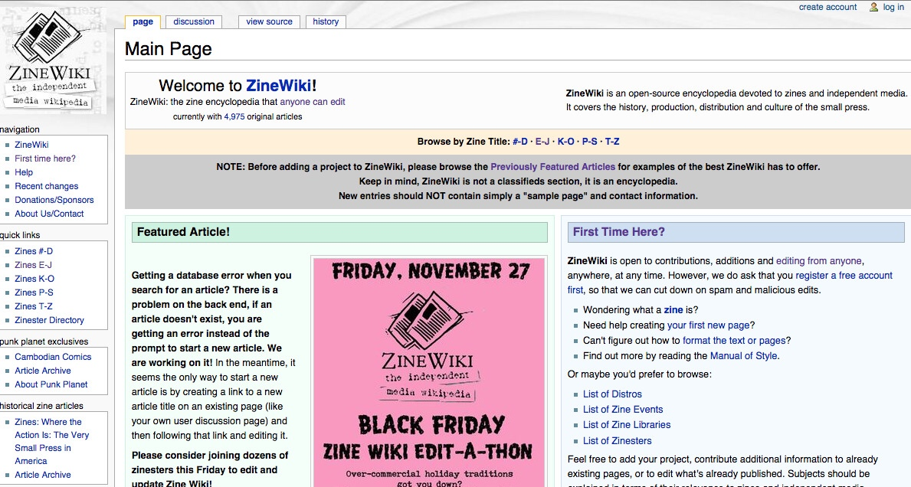
Jennifer @lasuprema & Allison @AllisonJaiODell for the Zine Libraries Interest Group, Zine Union Catalog Team

Slide 12
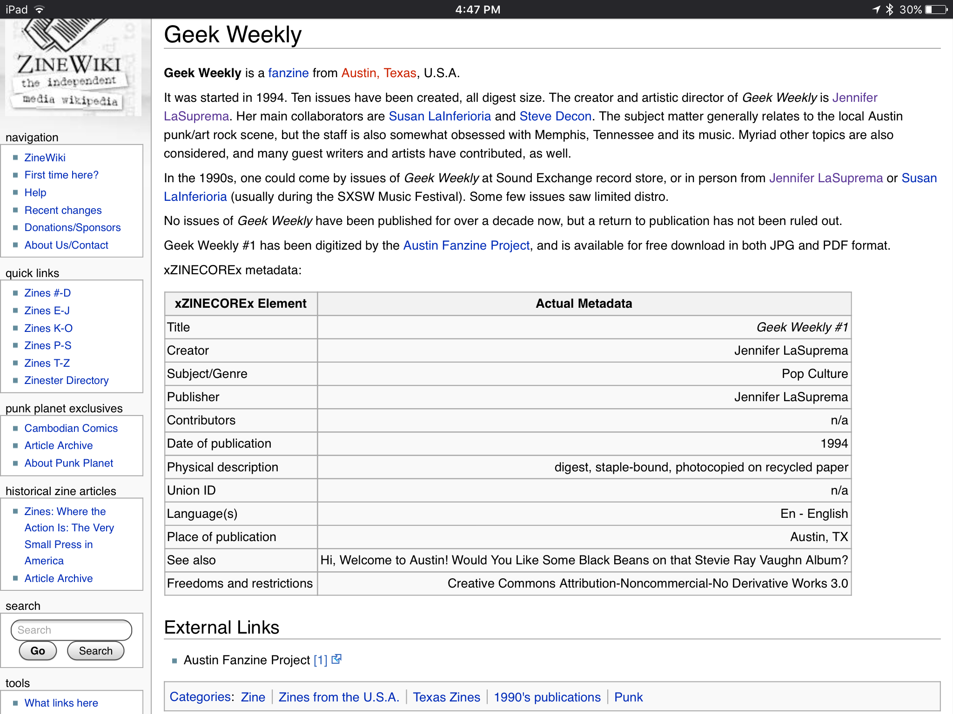
Jennifer @lasuprema & Allison @AllisonJaiODell for the Zine Libraries Interest Group, Zine Union Catalog Team

Slide 13
Zine Union Catalog (ZUC) Architecture
Built on:
xZINECOREx = schema
zinewiki.com = authority resources
$catalog = bibliographic resources
Jennifer @lasuprema & Allison @AllisonJaiODell for the Zine Libraries Interest Group, Zine Union Catalog Team
Notes:
… We can at least use ZineWiki URLs for unique identifiers, but we’re looking at the WikiData model for linked data, slurpable data magic. We’re also looking at partnerships and collaboration with the PCC, especially in support of their new Strategic Directions, aimed at opening up participation, and expanding relevance.
Step 3: build the catalog. We’re reviewing options (free and open source ones!): Collective Access, Koha, Kuali OLE, Omeka, Hydra, Mukurtu (MOOK-oo-too), Islandora, roll our own? … DPLA?!

Slide 14
Challenges
Volunteer-run, loose-knit organization
Zine metadata is diverse
omg serials
omg rare materials
Jennifer @lasuprema & Allison @AllisonJaiODell for the Zine Libraries Interest Group, Zine Union Catalog Team
Notes:
Volunteer base: coalition of the willing, but overextended. I’ve seen this on a number of great projects.
We need institutional partners to seek grant funding; need a dedicated development team.
Diverse metadata: how do we map and integrate it all? (from finding aids with aggregate description, MARC bibliographic records as both monographs and serials, from standalone databases and tables, from LibraryThing… and on top of that, digitized content) Should we provide an ingest service, or force others to comply with ZC and certain norms?
Cataloging zines is hard to begin with! Zines are serials that frequently change titles and come out on irregular schedules. Also, they’re rare materials, and benefit from in-depth description, with a variety of access points for a variety of research and leisure reading audiences.

Slide 15
DPLA Collaboration(s)?
Let’s hear some ideas!
Hub
Participation
App development
Jennifer @lasuprema & Allison @AllisonJaiODell for the Zine Libraries Interest Group, Zine Union Catalog Team
Notes:
Digitized zines from lots of collections available → hub?
We’re always looking for volunteers!

Slide 16
Contact/info
jenniferhecker.info/zuc-dpla
ZineLibraries.info
ZineWiki.com
Tweet at us or mail Jennifer at j.hecker@austin.utexas.edu...
Jennifer @lasuprema & Allison @AllisonJaiODell for the Zine Libraries Interest Group, Zine Union Catalog Team

Slide 17
Jennifer @lasuprema & Allison @AllisonJaiODell for the Zine Libraries Interest Group, Zine Union Catalog Team

Slide 18
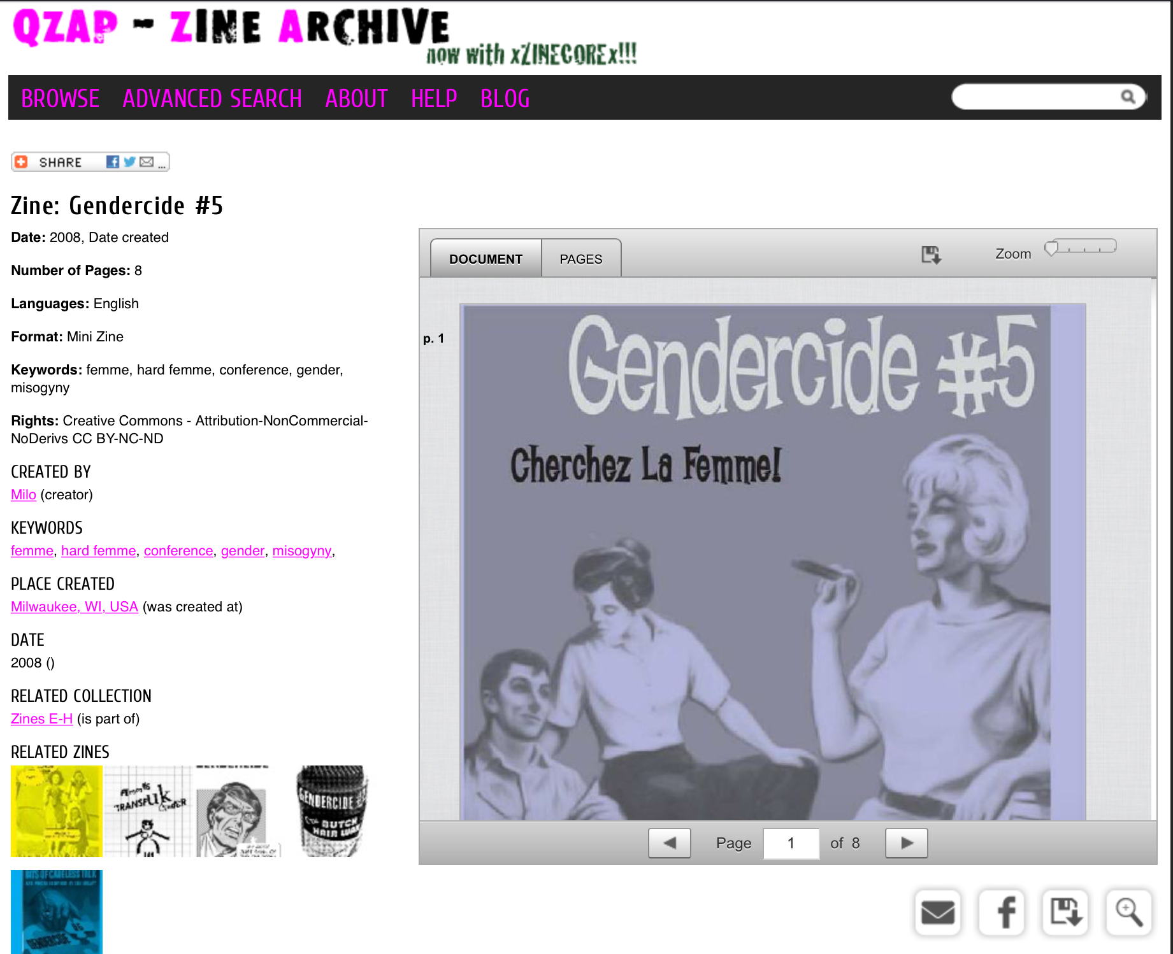
Jennifer @lasuprema & Allison @AllisonJaiODell for the Zine Libraries Interest Group, Zine Union Catalog Team

